Slide 1
Level Design & Asset Creation
A Forsaken Remake/Interpretation
By Garyn Jones
ST20267501

Slide 2
Overview
This project is aimed at re-envisioning levels from the 1988 Forsaken game using Unreal Engine 5. The focus was on 3D modeling, texturing, animation, level design and audio integration. Additionally, adding visual effects.
Goals: To create accurate lighting that creates a tense but realistic feeling of flying a bike through a cave system and military buildings while fighting enemies. Lighting also needs to represent the original game.
Creating particle effects to represent the original game.
Create detailed models, both high and low poly, for good details throughout gameplay.
To document all the steps along the way of creation from 3DsMax to texturing, animation and implementation into Unreal Engine 5, where I will make visual effects.

Slide 3
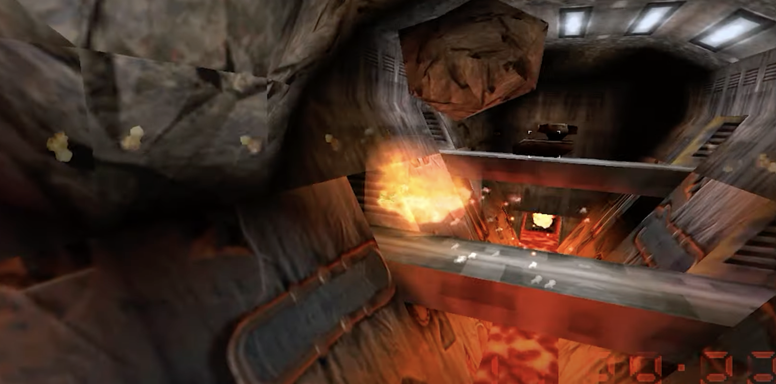
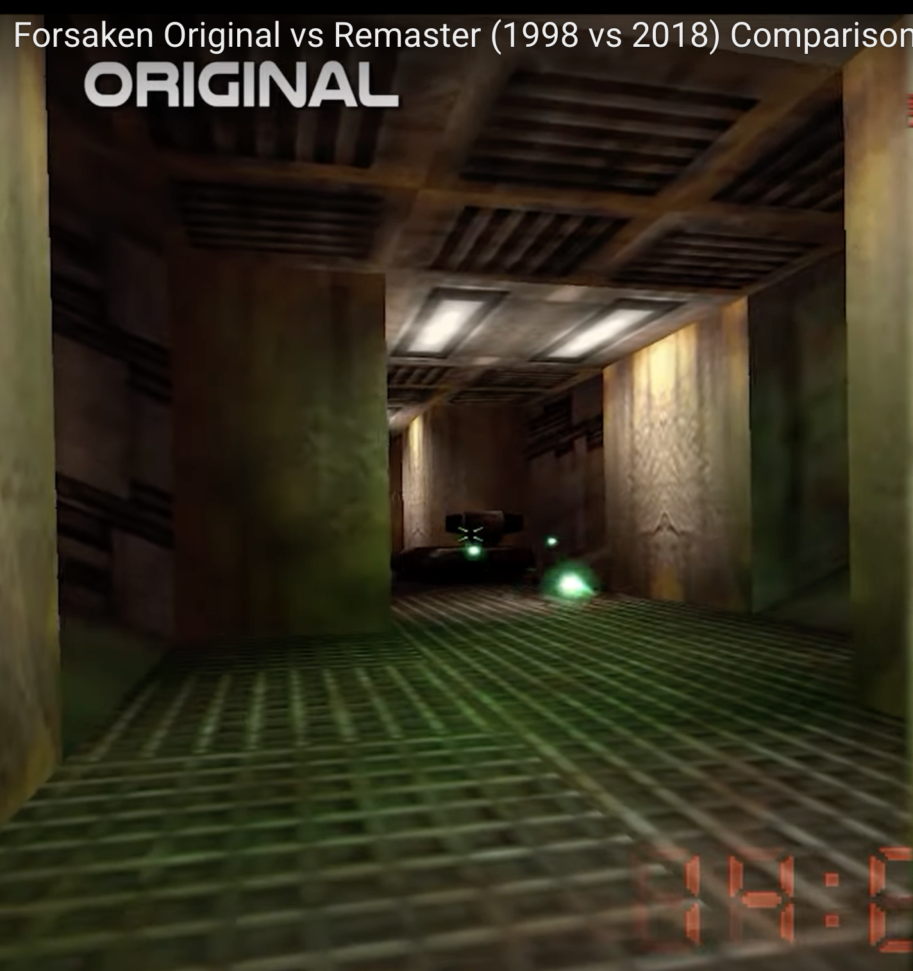
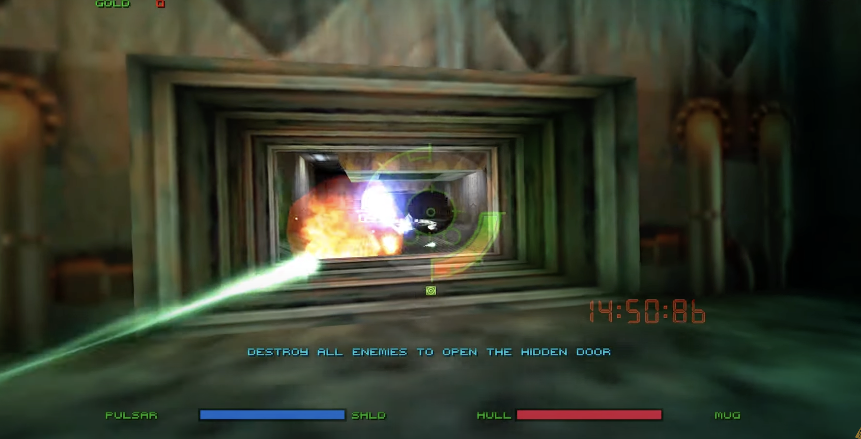
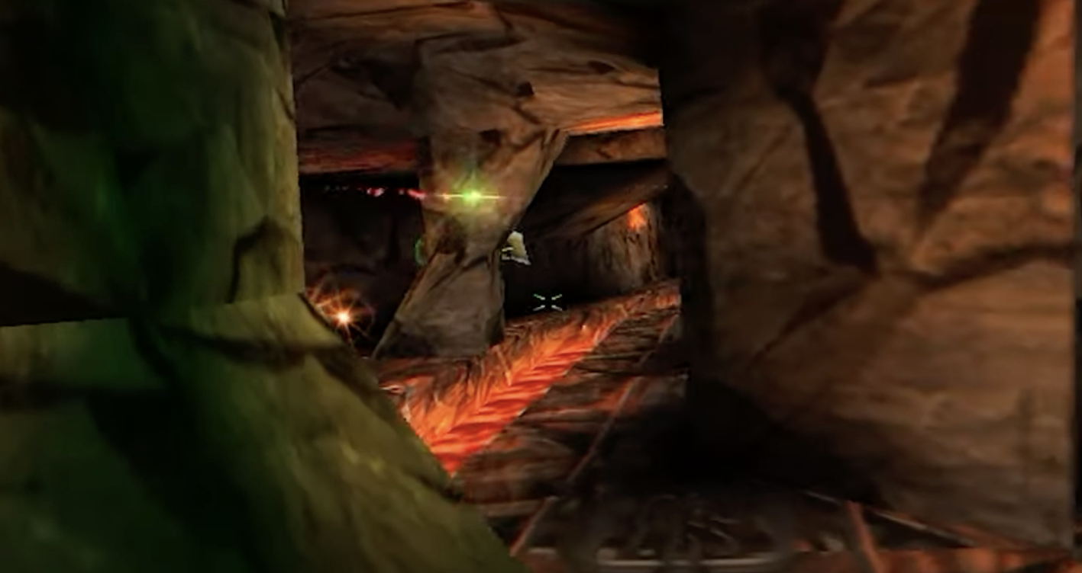
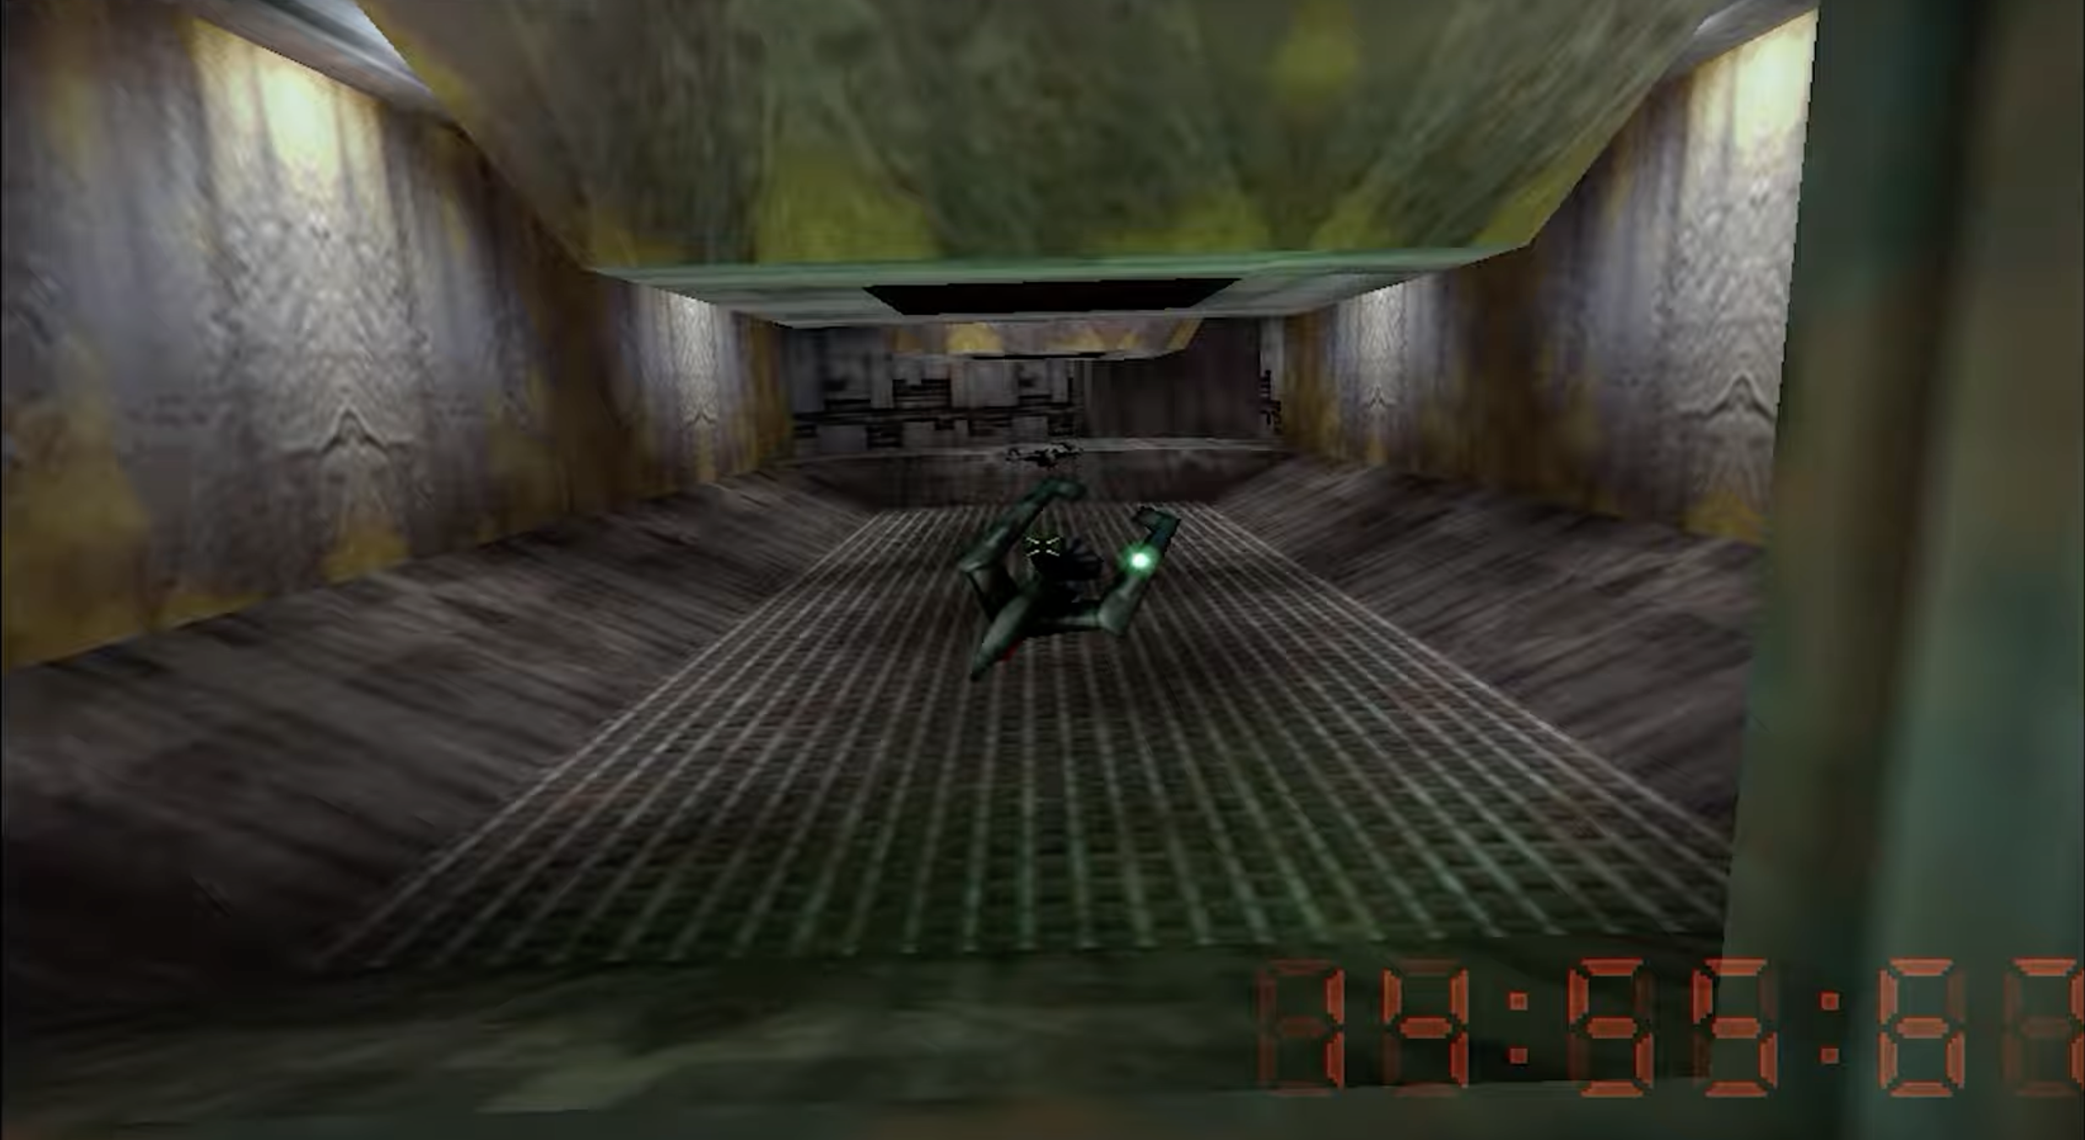
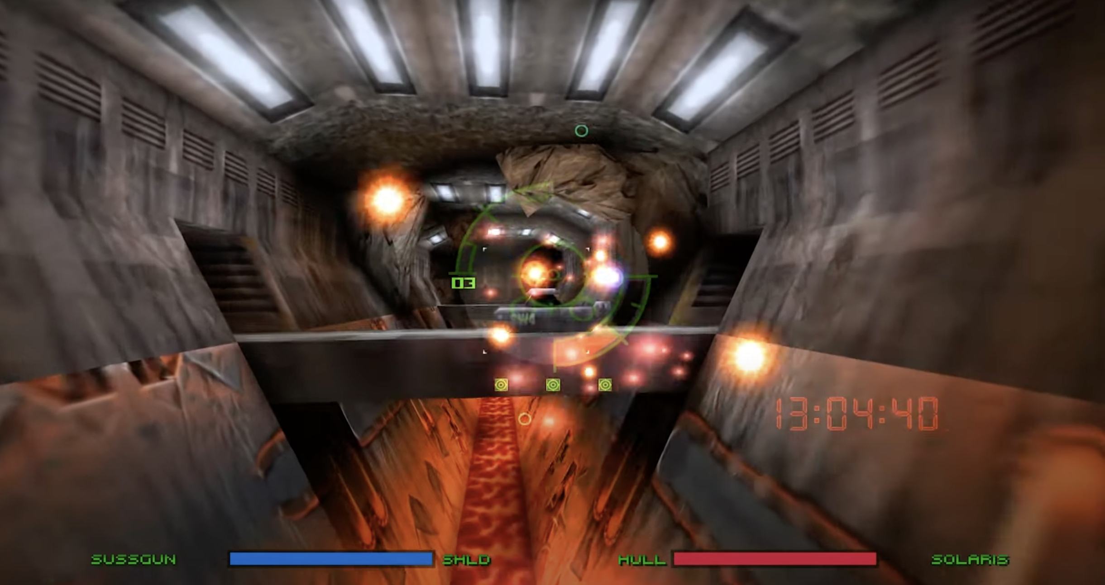
The images above are sourced from the original Forsaken video game released in 1988. These reference images are being utilised to recreate the levels in Unreal Engine 5. The goal is to produce similar scenes featuring advanced lighting, higher-quality textures, and models. These images will be featured throughout the portfolio, alongside their reimagined versions. All above images will be used as reference and content art.

Slide 4
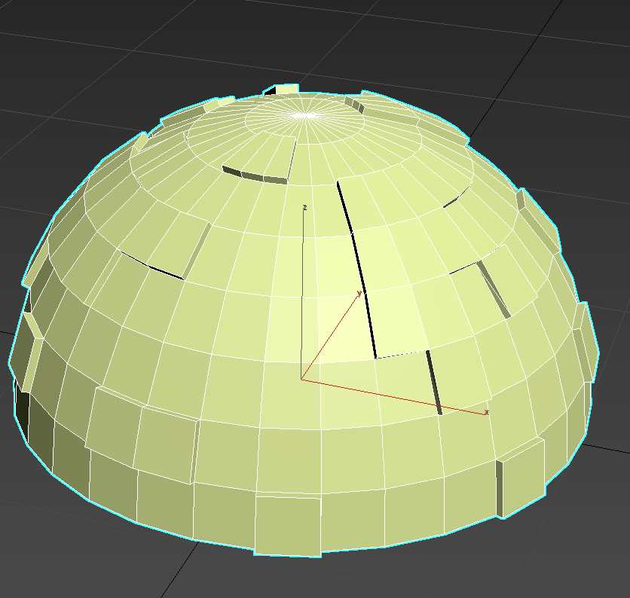
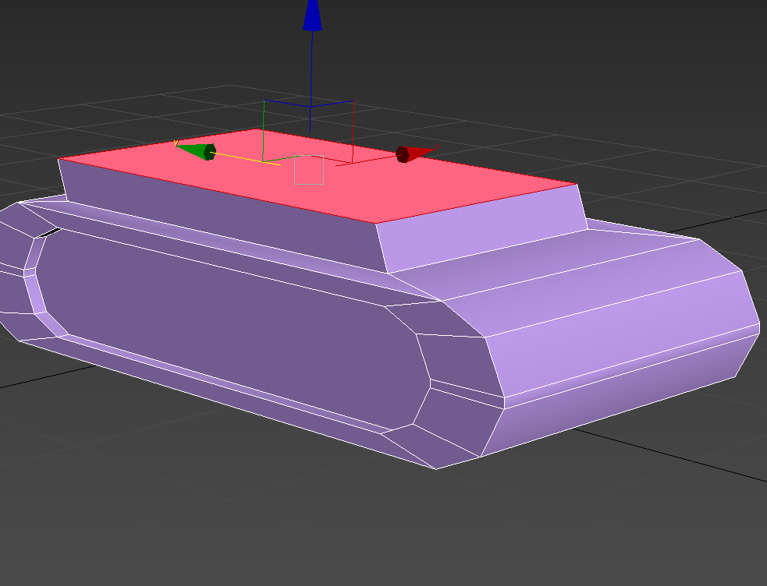
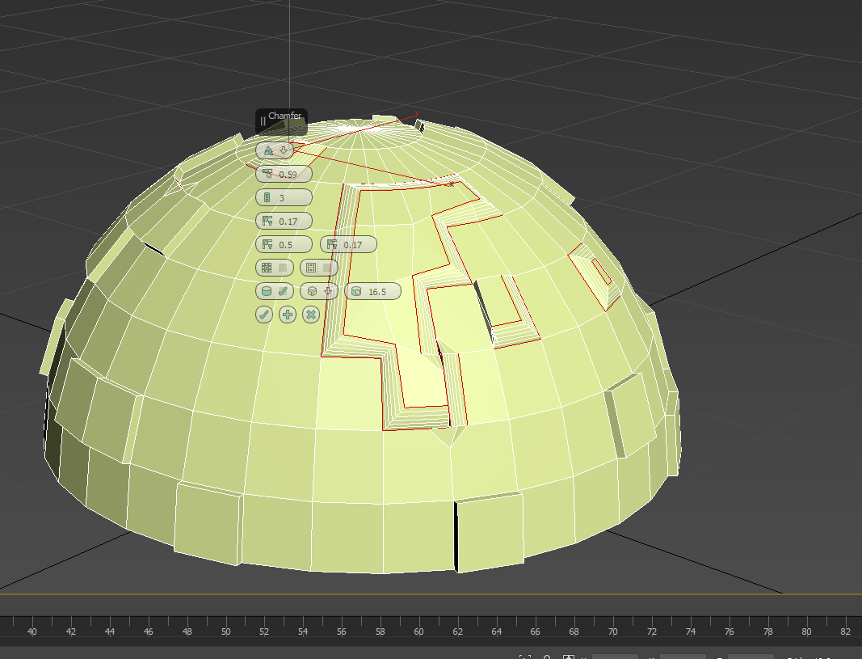
Extrude
Extrude takes a 2D shape or polygon or line and extends it outward along its normal or specific direction to create a 3D shape. It was used to extend certain areas of the models by adding length or height.

Slide 5
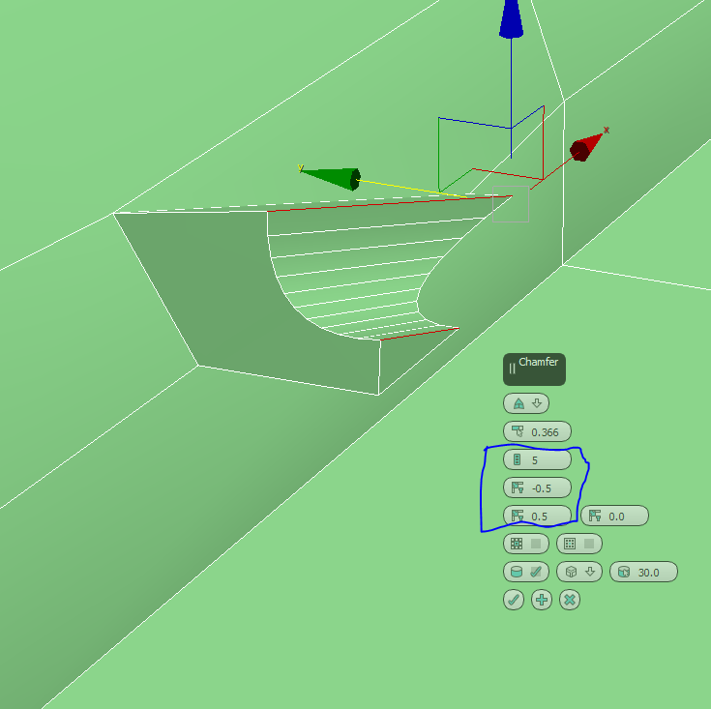
Chamfer
Chamfer, bevels or rounds off the sharp edges or corners of a 3D object by replacing them with a flat or curved surface.
This is achieved through adding geometry allowing for smoother corners depending on the amount of geometry added. Geometry is costly when creating a game and could dramatically reduce performance.

Slide 6
Cut & Target Weld & Weld
Cut simply destroys edges by slicing through polygons. This can be used to create more detailed modelling and can be used to prepare areas for further extruding.
Target Weld allows for editable meshes to have their vertices merged into one by click and dragging one into another.
Reducing vertices can be used to stop bad topology. This can help in lighting and less stress when using a model with bad topology in a game.
Weld merges two or more selected vertices into a single vertex. This can be used to removed any gaps or overlaps between them.
This is usually used to fix up geometry and altering the meshes topology.

Slide 7
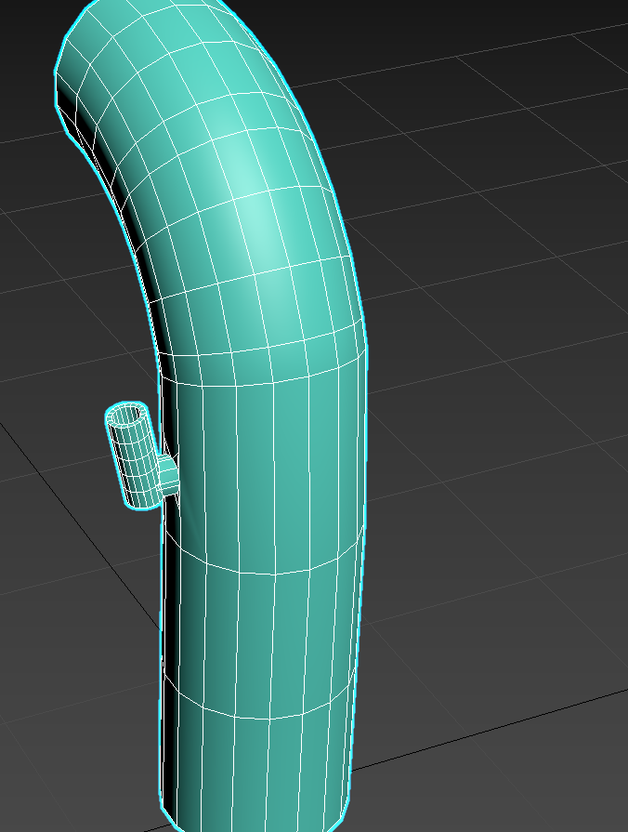
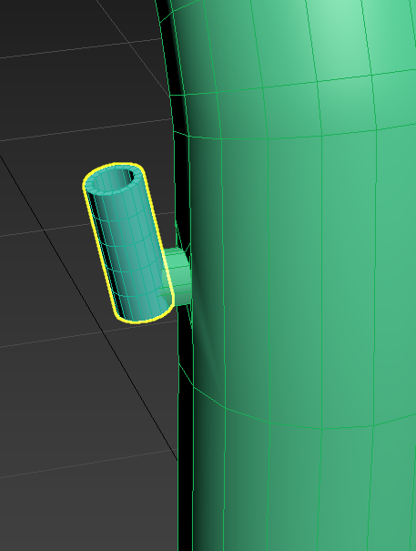
Connect & Merge
Connect creates new edges between selected vertices or edges, usually bridging them with a straight line.
Merge allows for 2 objects to be connected as 1 object. They can then be turned into 1 editable poly mesh.

Slide 8
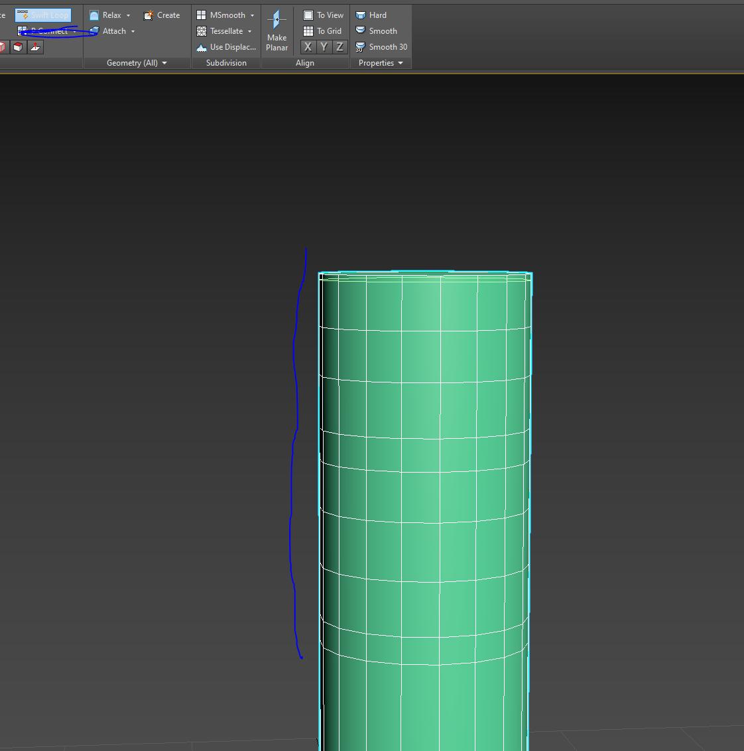
Swift Loop
Swift loop shows a line on the meshes topology and allows the user to place a loop around the entire model adding extra edges to the mesh.
The loop will not surround the entire model if the topology of the model is bad.

Slide 9
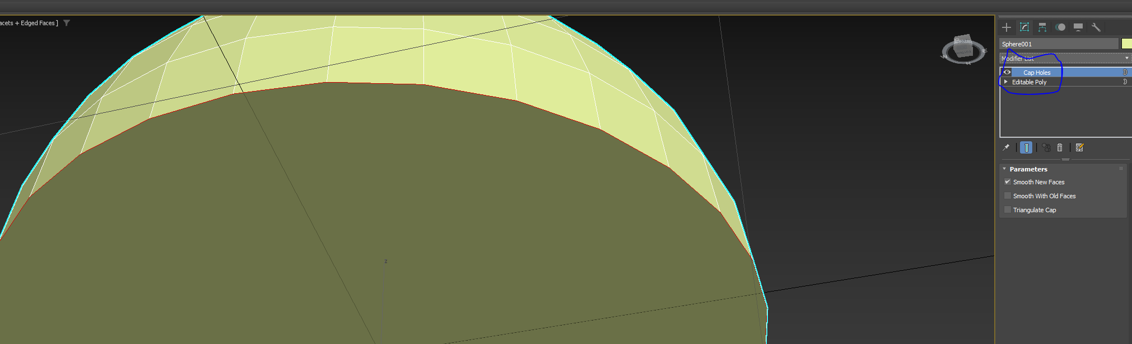
Cap Poly
Cap Poly fills a selected border or hole in a mesh with a new polygon.
This was used to cap the hole on the front and back of the bike model.

Slide 10
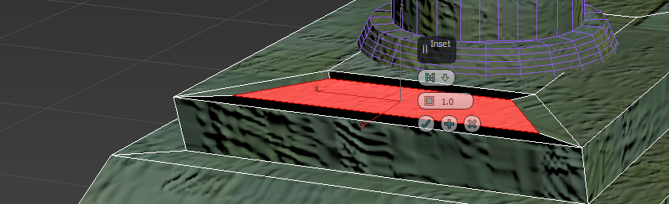
Inset & Bevel
Inset scales a polygons face inwards or outwards depending on the requirements.
This is done while also having an angle therefore making the inset smaller or larger on the wall edges.
Bevel combines Inset and Extrude in one operation. It lets you create a smaller polygon inside a selected face (inset) and then extend it outward or inward (extrude) simultaneously, adding depth and angled surfaces.

Slide 11
Bridge
Bridge connects two or more selected edges or faces or borders by creating new polygons to fill the space.
This was used in multiple models, for various occasions.

Slide 12
Symetry & Normal
Symmetry is a modeling tool that mirrors one side of a mesh across a chosen axis, creating a perfectly symmetrical duplicate on the other side.
This was used on the bike when fixing polygons on one side of the bike to get correct shading and lighting to mirror onto the other side without wasting time.
Normal is used to change the side of the face that the lighting will bounce off of a model.
This is usually used to ensure correct lighting and shading is applied throughout the entire model.

Slide 13
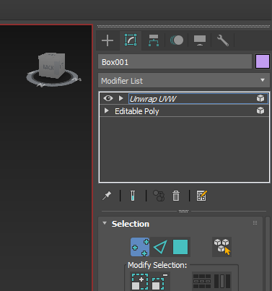
Edit Poly
Edit poly is a modifier that allows direct edits to be made the mesh at sub object level- vertices, edges, borders, polygons.
This is used in all of the models.

Slide 14
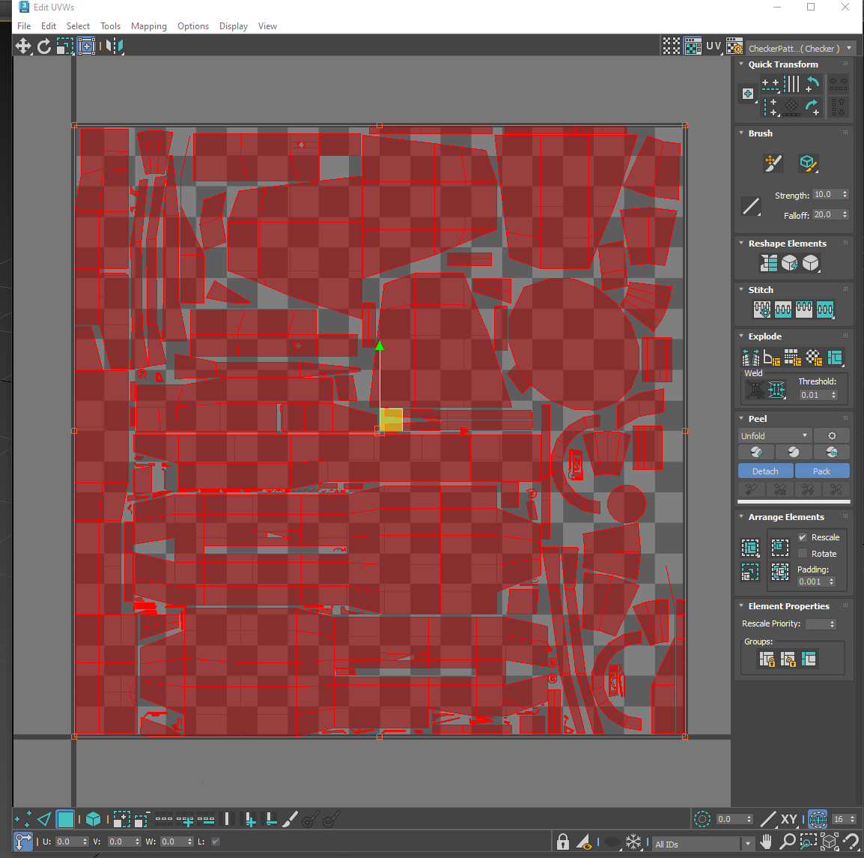
UVW UnWrap
UVW Unwrap is a modifier used to control how 2D textures are applied to a 3D model. It allows a texture to be mapped out on a 2D plain in a UV space.

Slide 15
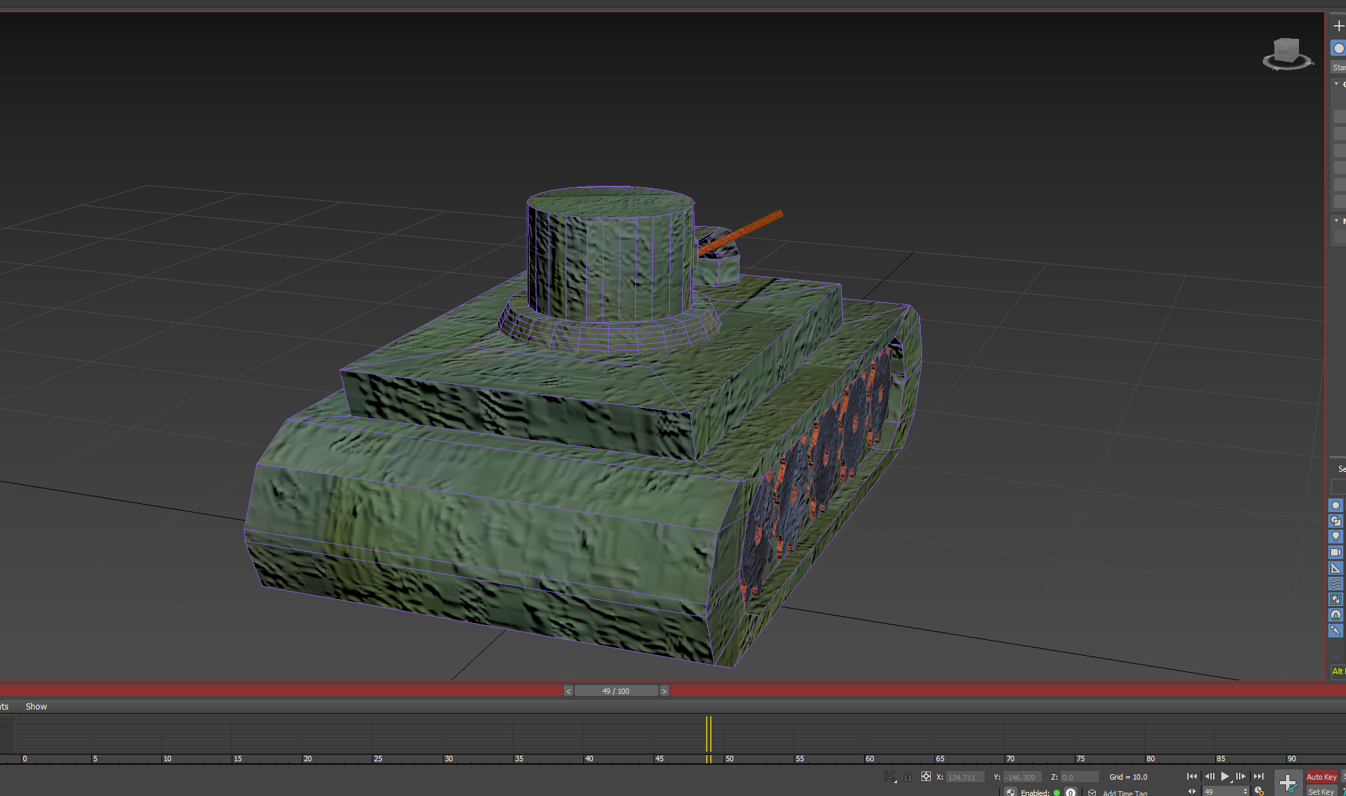
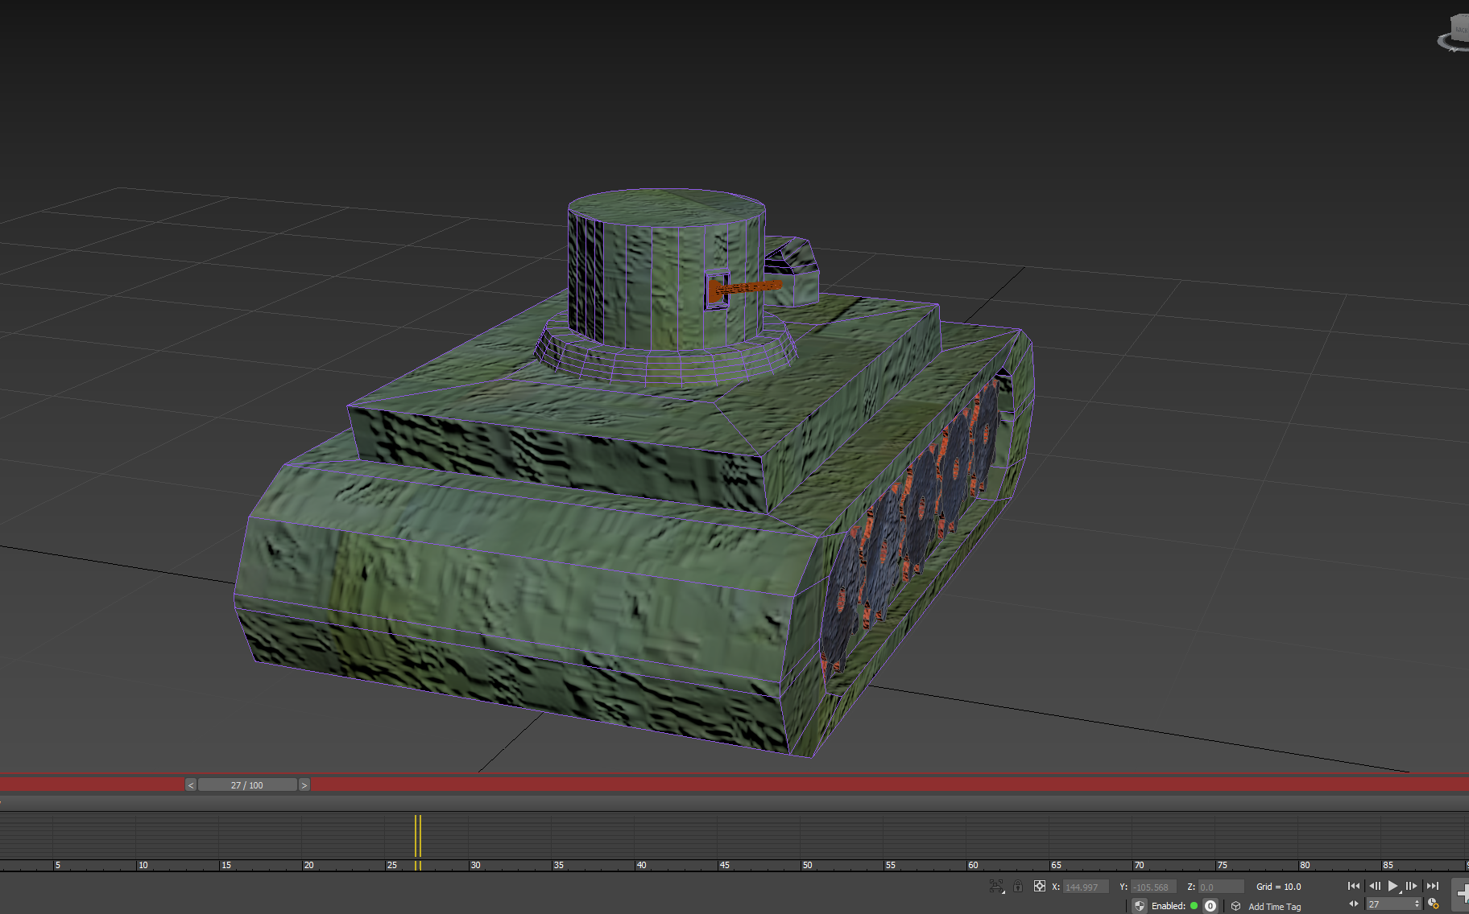
Animation
Animation is used to create “life” in certain models. The tank is given “life” by having multiple animations that allow for the head to swivel and the cannon to lift and lower.
The animation was done using the key button setting key points of the tank in a different position across the timeline. The timeline then creates the frames in between each key pose. Thus, creating a flowing animation form frame 1 – 70 or wherever the frame ends.

Slide 16
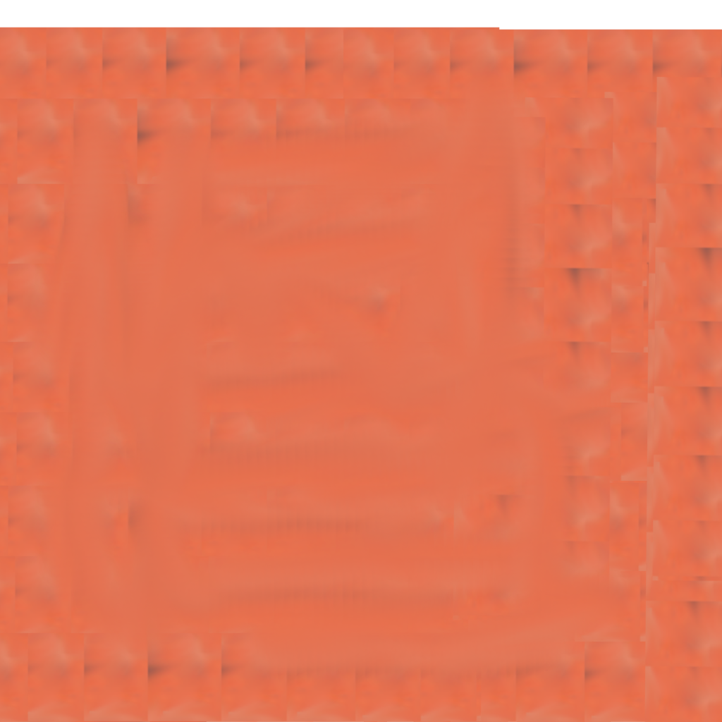

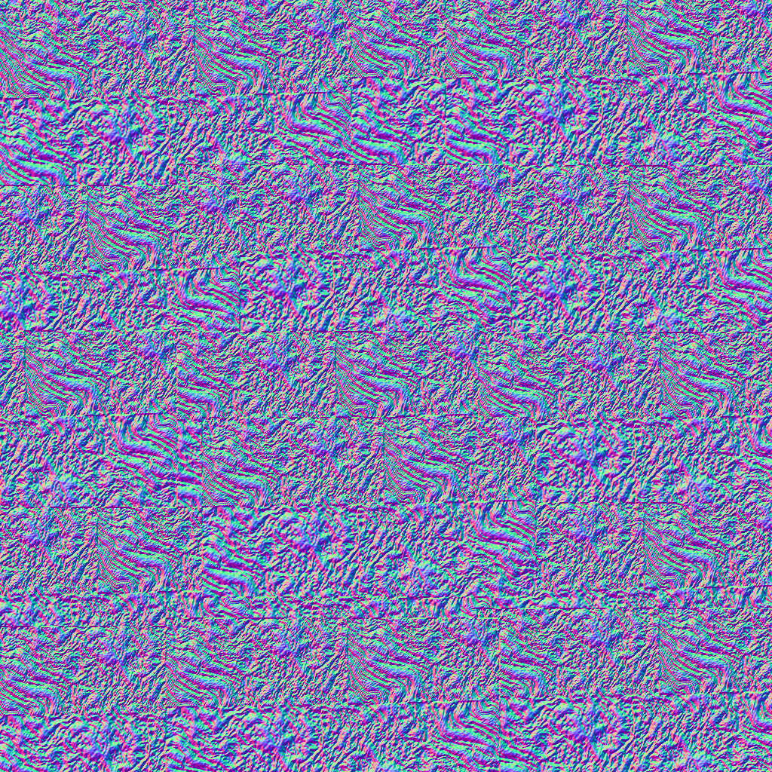
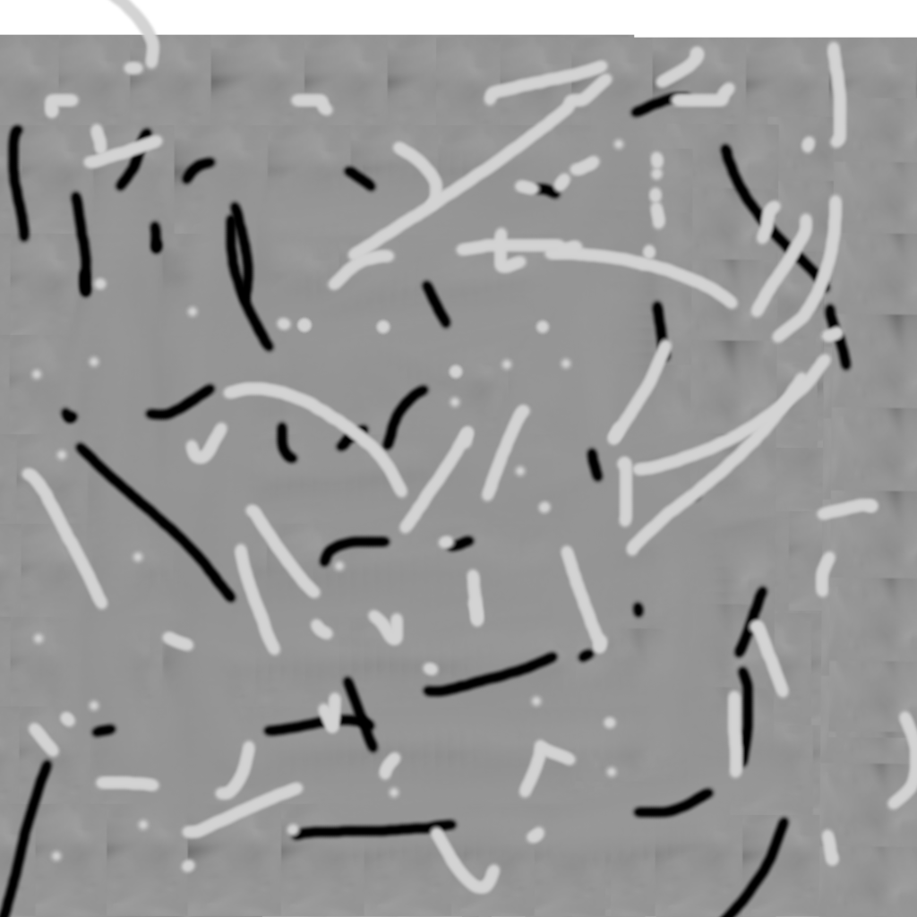
Gimp
Gimp is a type pf photoshop software that allowed the creation of 1024 by 1024 textures to be made. These textures are small in size and also small to make high quality textures on.
Normal
Displacement
Base Colour
Emmision

Slide 17
Asset Import Unreal Engine 5
Asset import in Unreal Engine 5 is a process of bringing external content like 3D models, textures, animation and audio into a project.
Fbx files were imported in from 3DsMax into Unreal Engine 5 along with the animations.

Slide 18
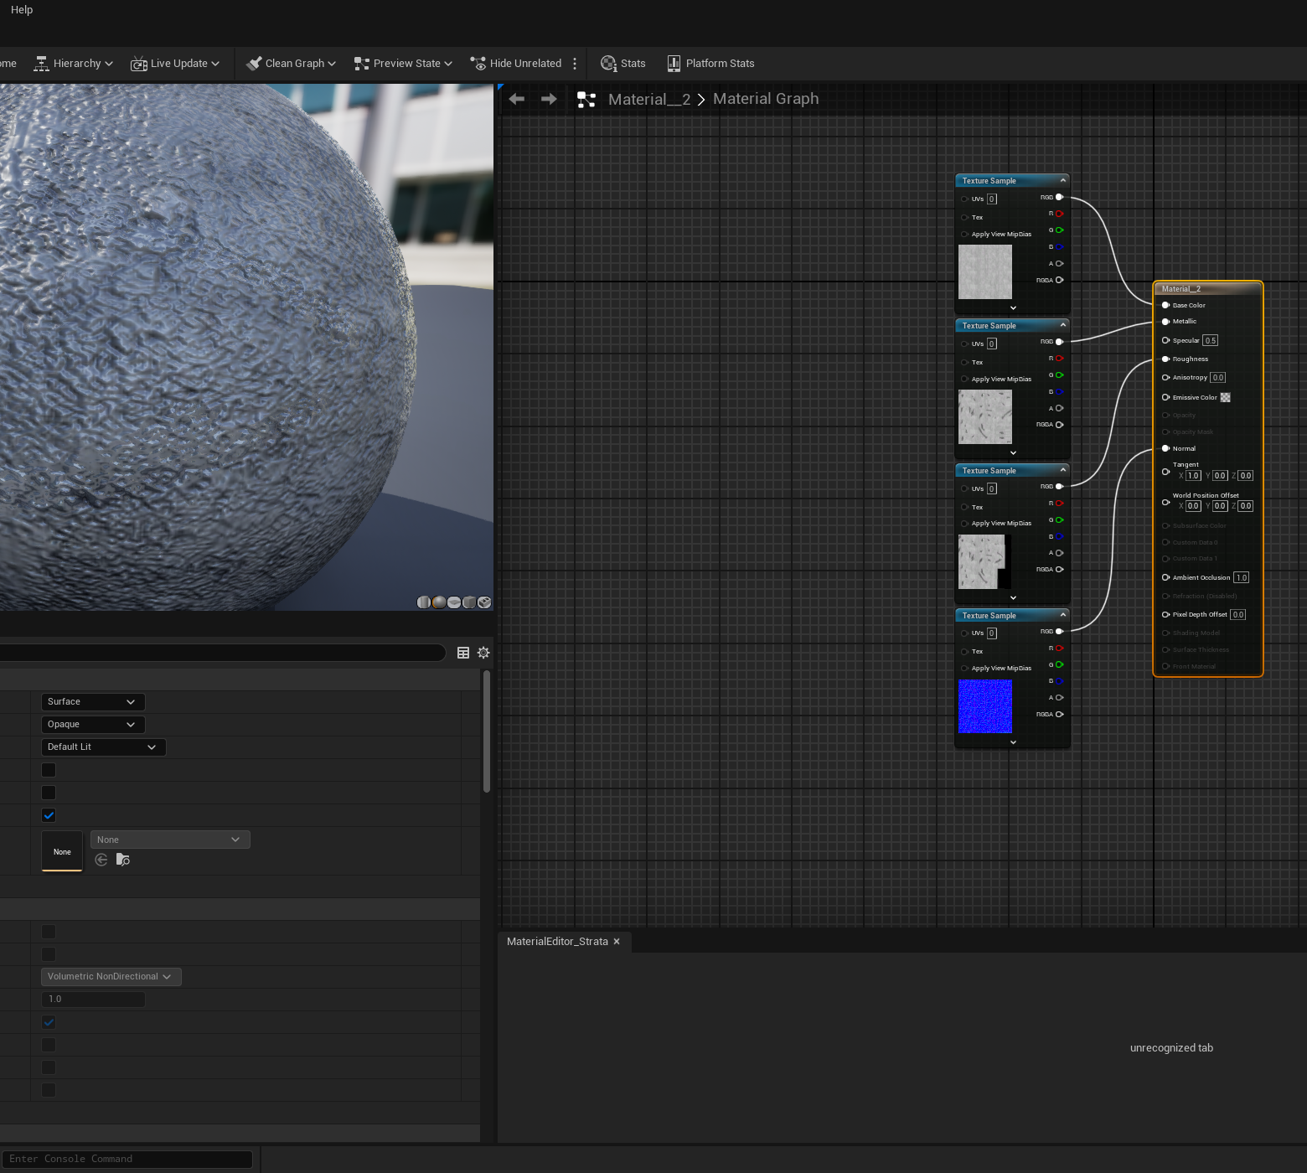
Texture Maps in Unreal Engine 5
Texture maps are images applied to 3D models to define surface details, colour, and material properties.
Texture maps were applied to the model in 3DsMax and then made into the material within Unreal Engine 5 using blueprints.

Slide 19
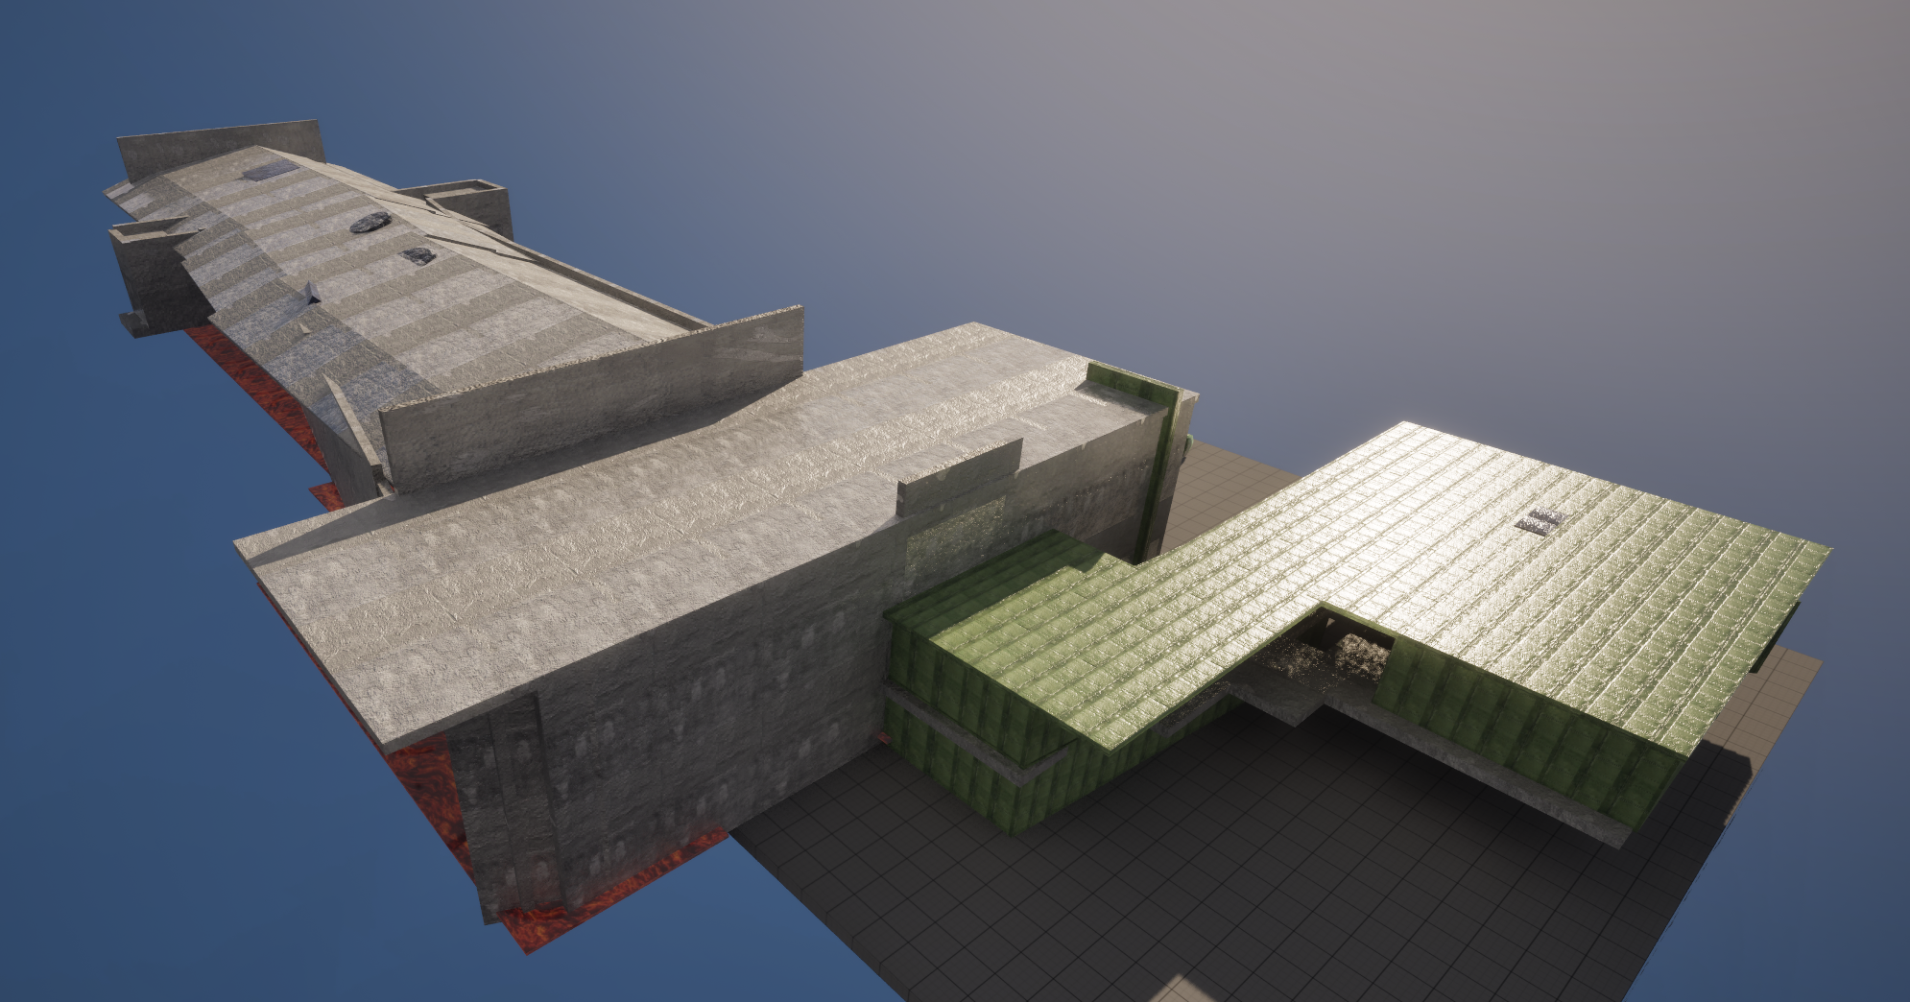
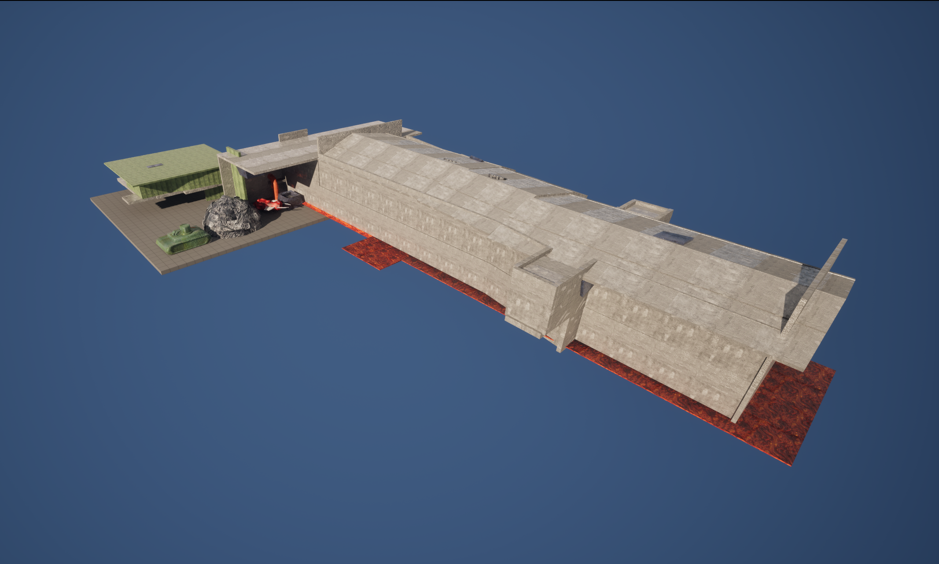
Level Design in Unreal Engine 5
Level Design was done using the models that were imported from 3DsMax and then scaled up in Unreal Engine 5.
The models were then placed in as grey box originally. Before being transformed into a lit and filled out environment that represents two levels from the Original Forsaken game.

Slide 20
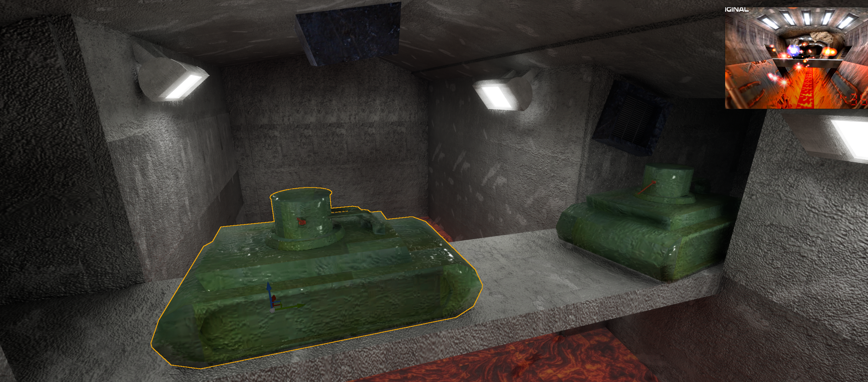
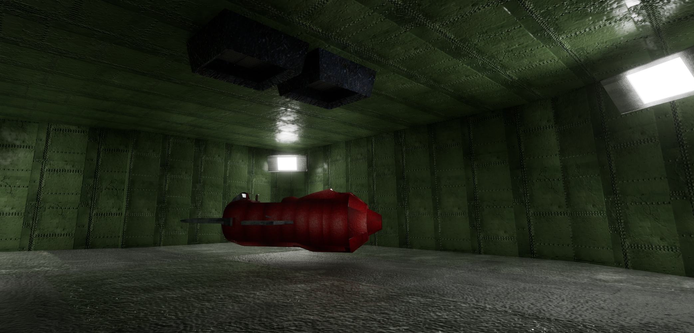
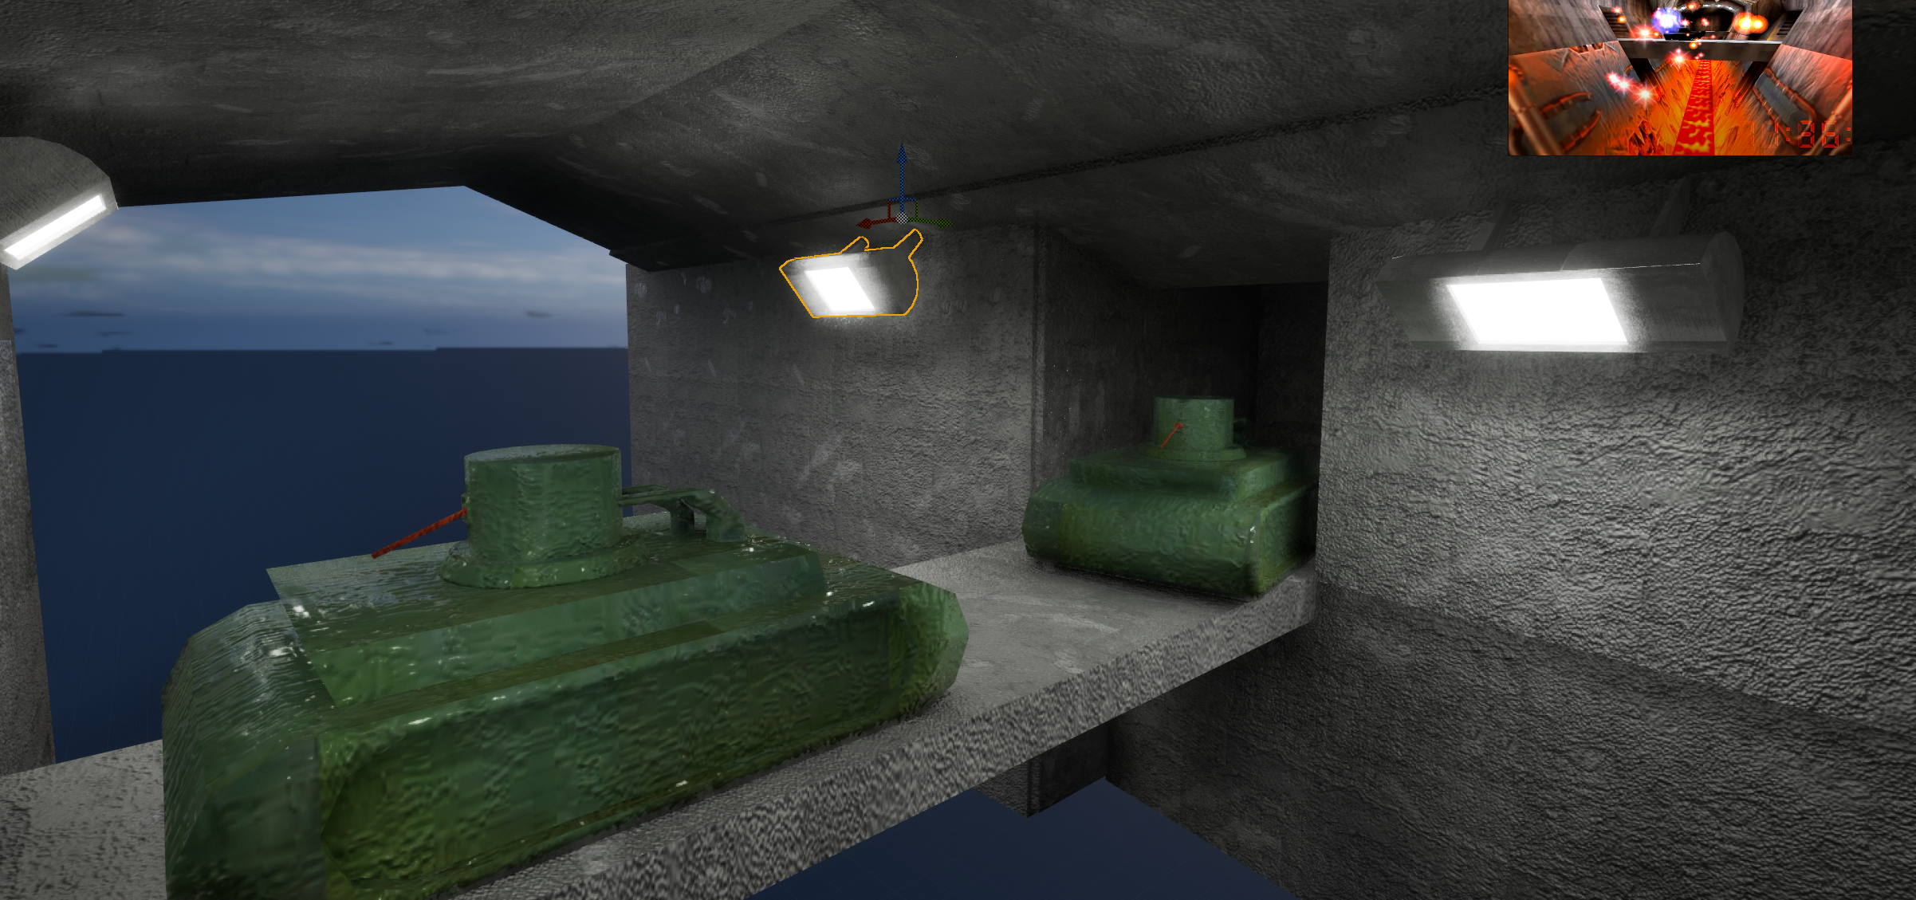
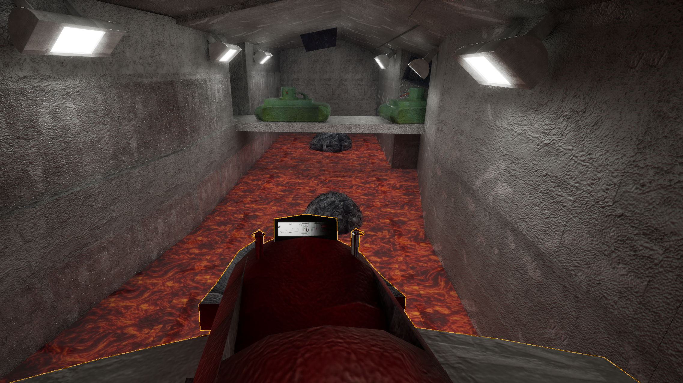
Unreal Engine Lighting
Lighting was created from the light model that was created in 3DsMax and was created to have a directional light source that spans out of a different radius depending on the light level set for the model.

Slide 21
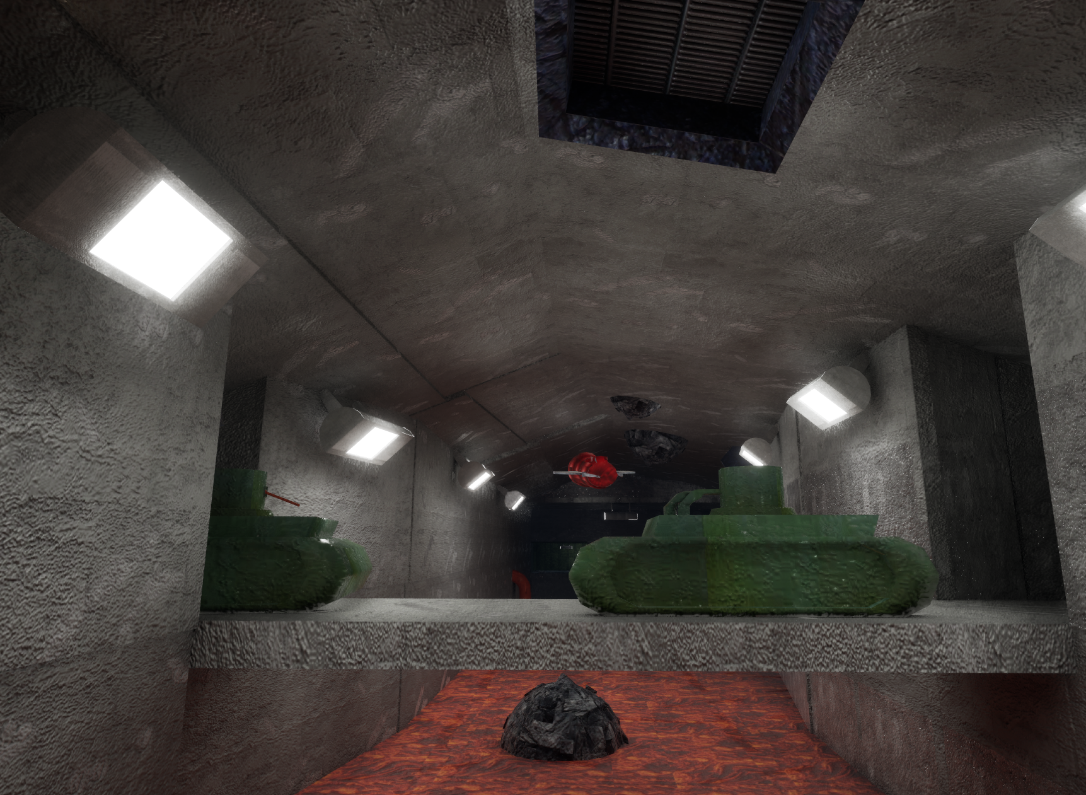
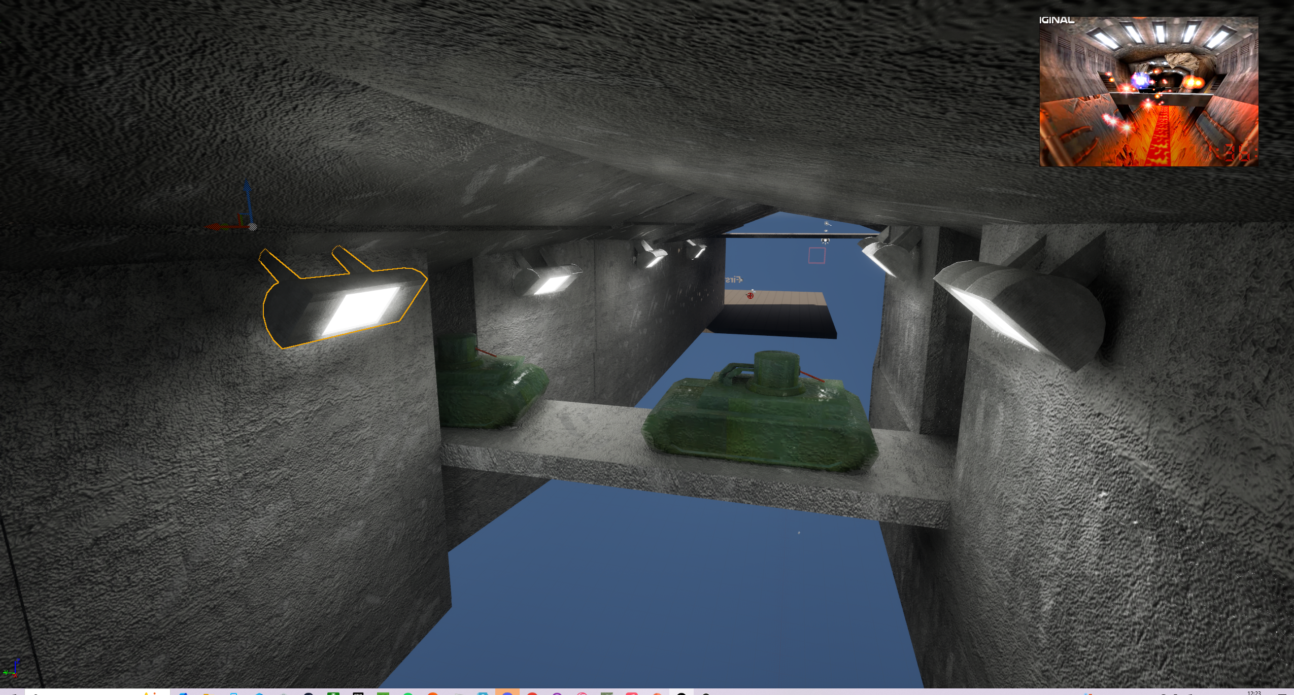
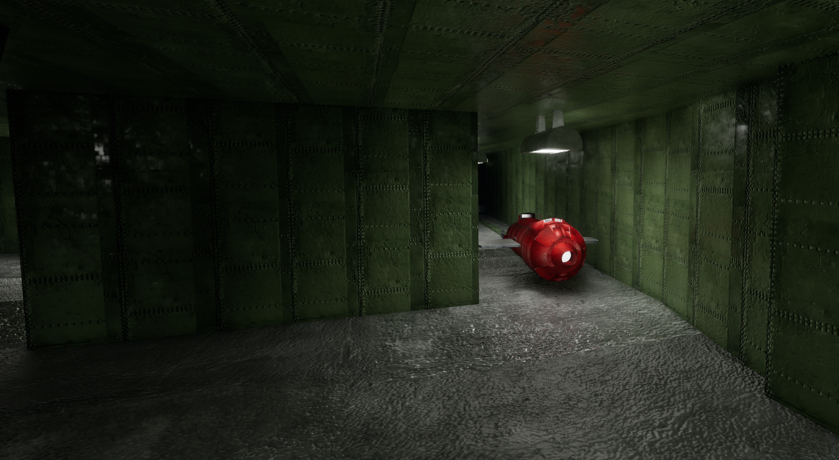
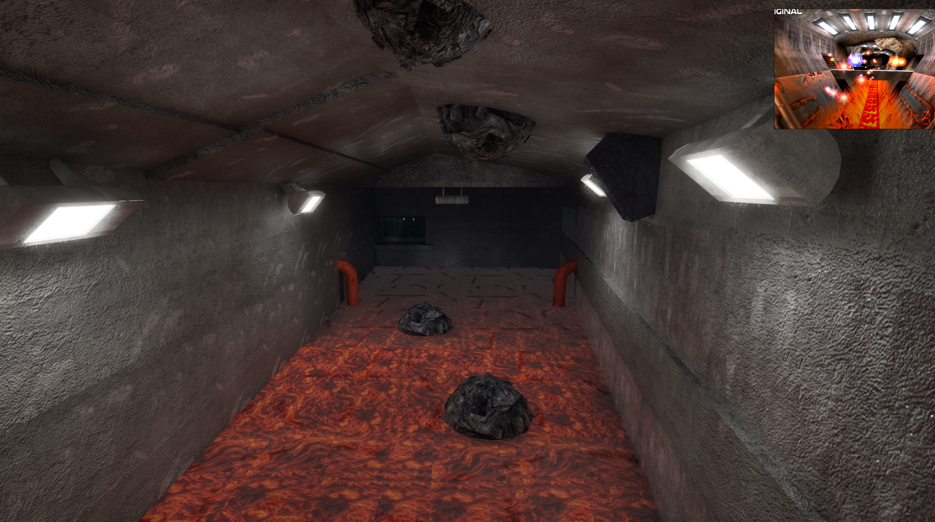
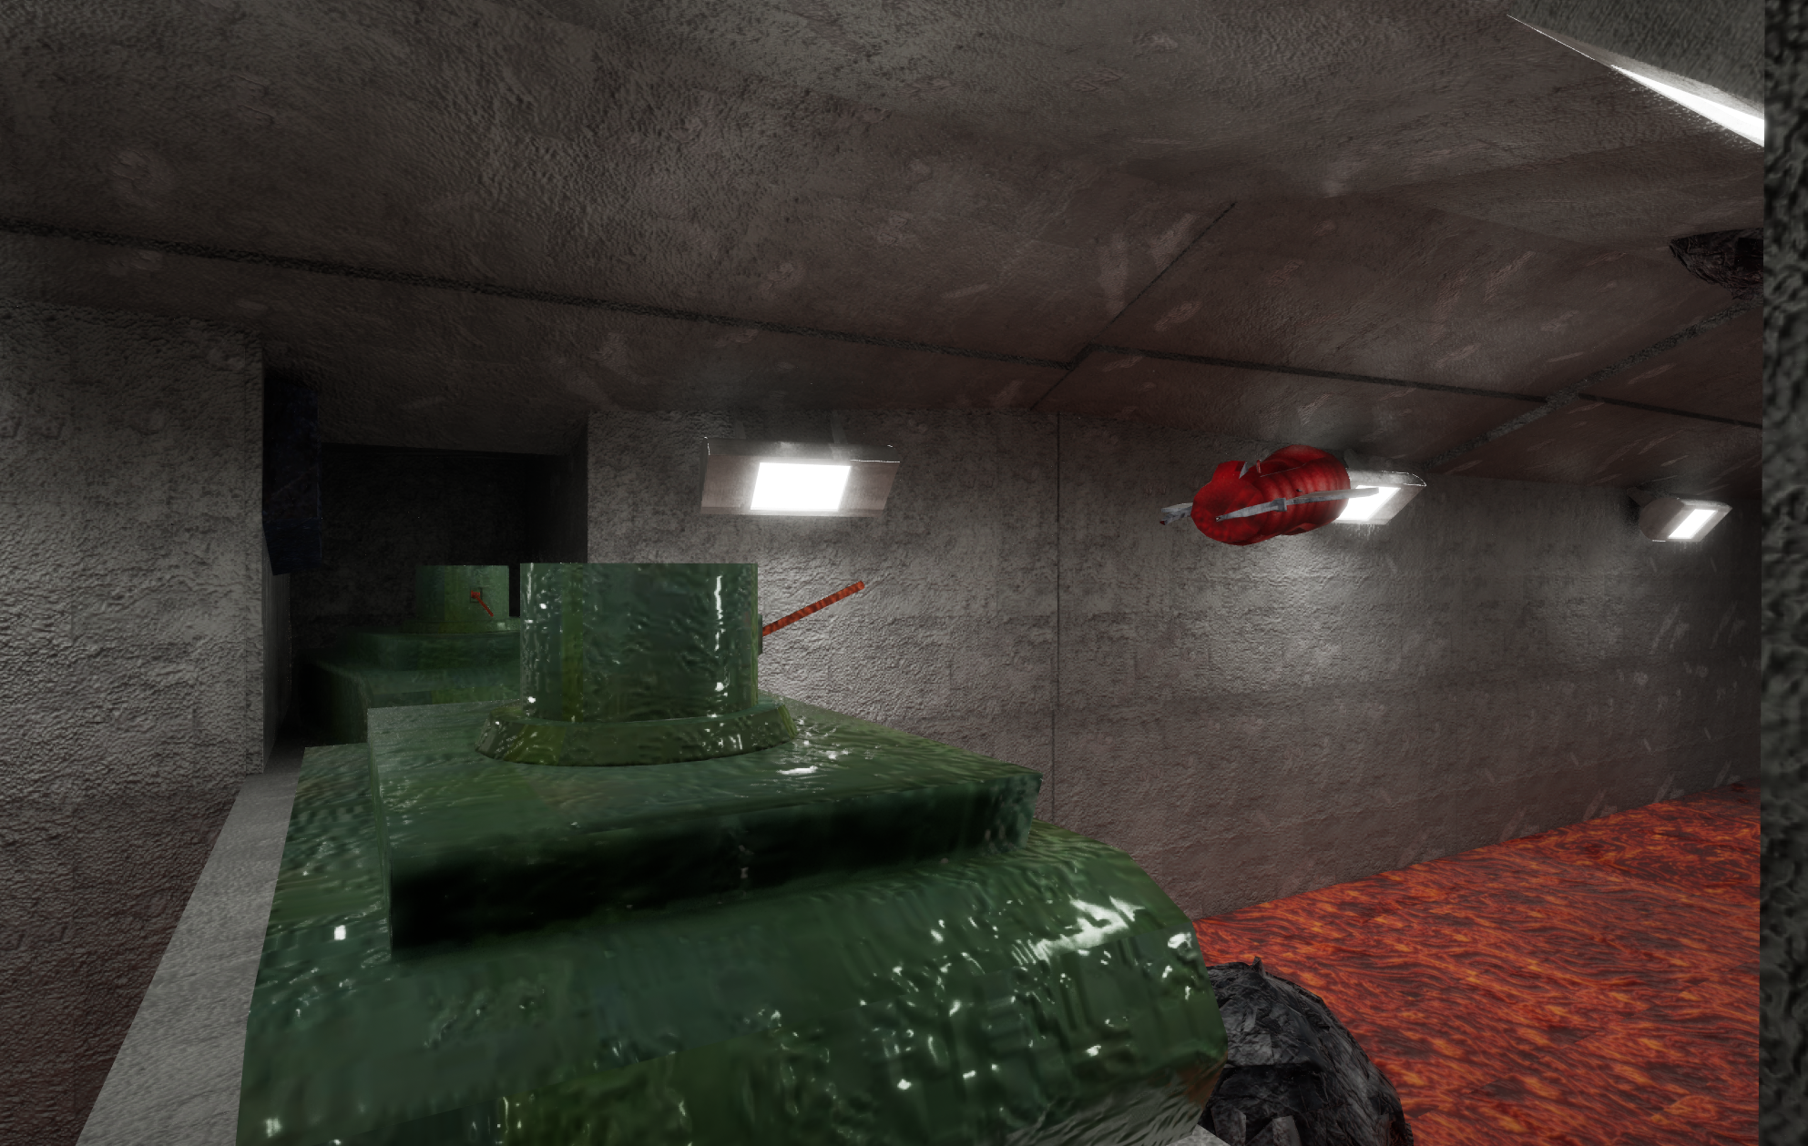
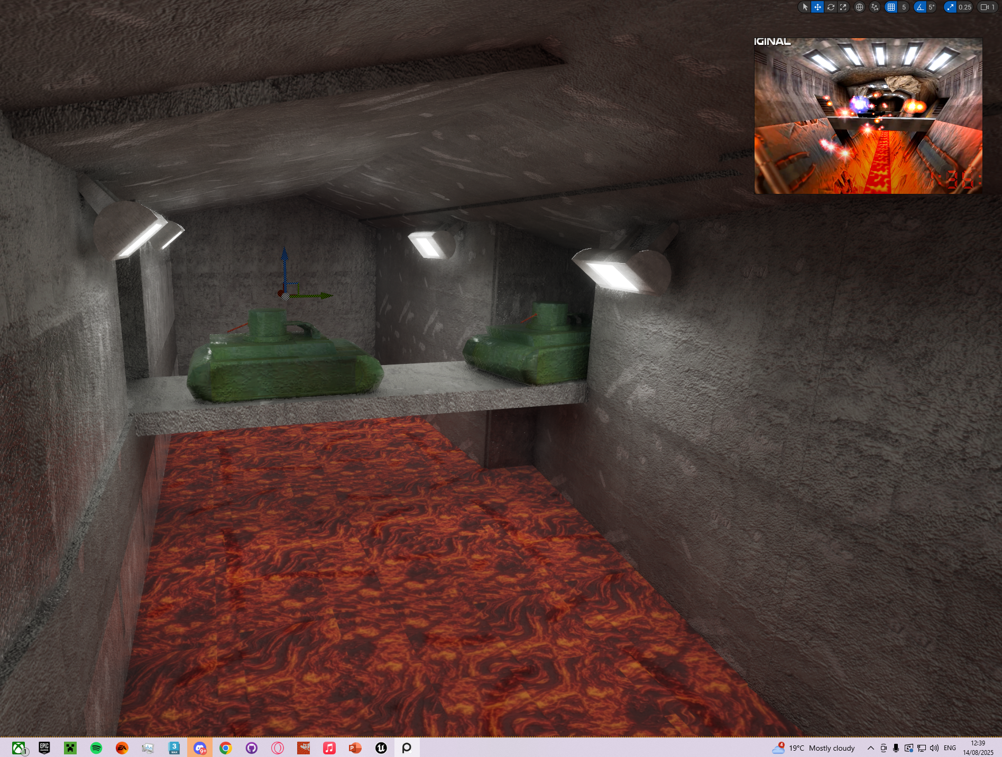
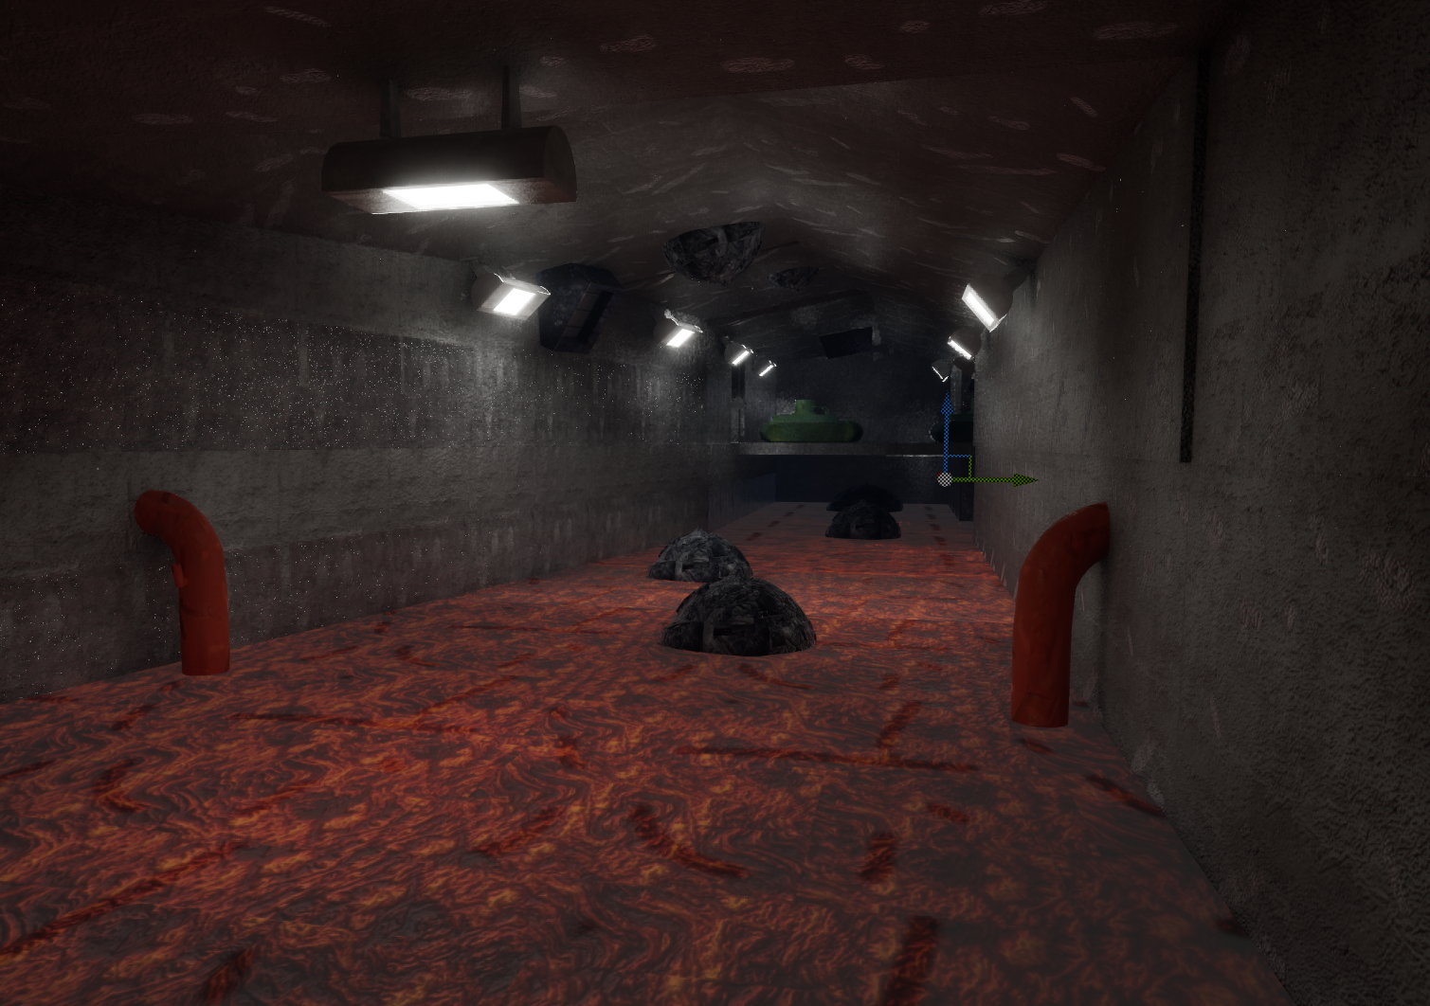
Unreal Engine Final Product
Final Level Layout

Slide 22
Summary
To summarise next time, I would focus more on Unreal Engine 5 to ensure I could have visual effects as well as more audio effects. This could be achieved by managing time more efficiently.
Overall, the level looks good with lighting coming from lava and the lights I think it creates a cool ambient effect. The models fit the scene well while also representing the original game.
Git Hub Repositry Link: https://github.com/Garyn565/ForsakenRemake
Youtube Link: https://youtu.be/5aDY-i2gJh4?si=agCkItGA6lJoa5zZ

Slide 23
Reflection
To reflect on my previous assignment I would say I managed my time better this time around allowiung me to create a mich better portfolio as well as better textures, models and this time I ensure that I would hit as much of the mark scheme criteria as possible. This was achieved with the level design blockout.

